Slide 1
Project Presentation
Project Title: AI Based Career Guidance System
Presented by :
Monowar Hossain Aman
-
-
1

Slide 2
Roadmap
Introduction
Tech Stack
Problem definition
Implementation and Result Discussion
Literature Survey
Model Inference Demonstrations
Proposed System
Conclusion and Future Work
Dataset
References
Design Diagrams
2

Slide 3
Introduction
With rapid growth of internet, there has been a huge amount of information being made available to the user which often leads to an information overload and thus needs to be organized efficiently.
Students often face a dilemma in deciding to choose a career in their life. There are several factors that influence the students when choosing their career path such as their personal aptitudes, educational achievements and their environment.
Students have always faced challenges when it comes to getting effective but free guidance with respect to career choices and advice, especially in developing or underdeveloped countries.
This large disparity leads to an increasing number of students, who lack the resources to network with other professionals in their dream career roles.
3

Slide 4
Problem Definition
Apart form proficiency skills in various domains and concepts of Computer Science, a candidate’s psychological traits also played an important role in predicting their career.
With sufficient literature reviewed and individual datasets obtained, we form our problem definition as:
“To combine datasets of psychological traits and proficiency in technological skills
and apply Machine Learning models to predict the career of an individual in the field
of Computer Science delivered through an interactive frontend.”
4

Slide 5
Literature Survey
Approaches | Advantages | Disadvantages
Data Mining & Machine Learning | • When it is exposed to new data, it changes to accommodate the new data points. • Handling multi-dimensional data • Automated process | • Requires sufficient annotated dataset.
Recommendation System | • Does not require specific domain knowledge • Recommendations given not in an isolated sense but based on similar users interest too | • Scalability • Limited choice of algorithms • Limited adaptability to changing
Expert Systems and Fuzzy Logic | • Make things more efficient by reducing the time needed to solve problems • These systems are able to accommodate several types of inputs including vague, distorted or imprecise data. | • Dependant on human knowledge • Regular updates required
Reinforcement Learning | • The model can correct the errors that occurred during the training process. • Reinforcement learning is Adaptable, it adapts to new environments automatically on the fly. | • Wrongly assumes world to be markovian. • Need for large amount of data. • Not suitable for problem statement.
NLP & Chatbot | • NLP tools help to analyze customer feedback on the go, which helps to continuously upgrade the model. • Works good where the model involves scanning candidates’ cv for recommendation | • Constant maintenance • Complex programming
5

Slide 6
Proposed System
The system will have a user-interface to allow for smooth user interaction with the recommendation model. The different components of the UI will include a questionnaire, the result page with the result of the recommendation model and detailed career profiles/description pages that will be connected with the backend.
The methodology adopted to carry out the implementation follows the machine learning pipeline approach starting from problem definition, dataset creation, dataset selection, data preprocessing, feature selection, implementation of various algorithms, choosing the best performing model, packaging the model and deploying the same in a user interface.
Problem
Definition
Dataset
Selection
Data
Preprocessing
Feature
Selection
Modelling
various
algorithms
Hyper-
parameter
Tuning
Choose
best model
6

Slide 7
Dataset
Dataset A: Skills & Proficiency
Dataset B: Personality Traits
1. Dataset Collection: Dataset with 18 columns
2. Data Preprocessing: Removal of null values, dropping missing rows and normalizing the dataset.
3. Label Encoding: Replace the categorical labels with numeric values. This dataset has 7 classes, hence there are 7 labels (1-7).
4. Feature Selection: Feature selection not required. All 17 features used.
1. Dataset Collection: Dataset with 11 columns: 10 independent variables, 1 dependent variable.
2. Data Preprocessing: Removal of null values, dropping missing rows and normalizing the dataset. Keeping only roles relevant to the field of computer science.
3. Dataset Mapping: Replace the predictor variable roles with those in the skill proficiency dataset.
4. Feature Selection: Feature selection not required. All 10 features used.
7

Slide 8
Dataset Mapping
Role as in the Personality Dataset | Mapped Role according to Proficiency Dataset
Project Executive | Application Support Engineer
Network Security Engineer | Cyber Security Specialist
Business Intelligence Analyst | Business Analyst
Internet Designer | Graphics Designer
Compliance Specialist | Information Security Specialist
Network Director | Networking Engineer
Computer Architect | Hardware Engineer
Computer Consultant | Helpdesk Engineer
Business Developer | Project Manager
Business Programmer | Data Scientist
Oracle Developer | Database Administrator
Software Writer | Technical Writer
8

Slide 9
Dataset Merging
3 Approaches considered:
Mean value
Overfitting
Mean values of variables in personality dataset for each role
assigned to respective roles in the technical dataset.
Randomized matching
Random set of values of variables in personality dataset
dataset. for each role assigned to respective roles in the technical
Overfitting
Many-to-many join
Mean values of variables in personality dataset for each role assigned to respective roles in the technical
dataset.
9

Slide 10
Dataset A
Software Developer | Technical skill A | Technical skill B | Personality trait 1 b | Personality trait 2 b
Dataset B
Software Developer | Personality trait 1 a | Personality 2 a
Software Developer | Personality trait 1 b | Personality 2 b
Software Developer | Personality trait 1 c | Personality 2 c
10

Slide 11
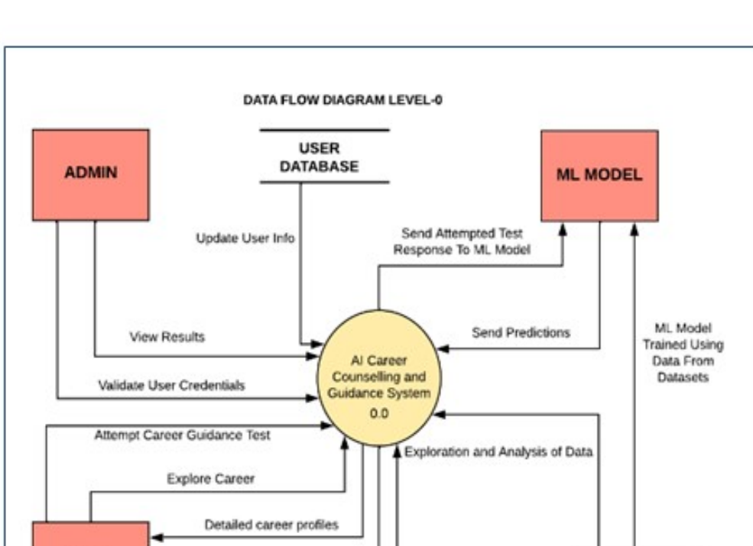
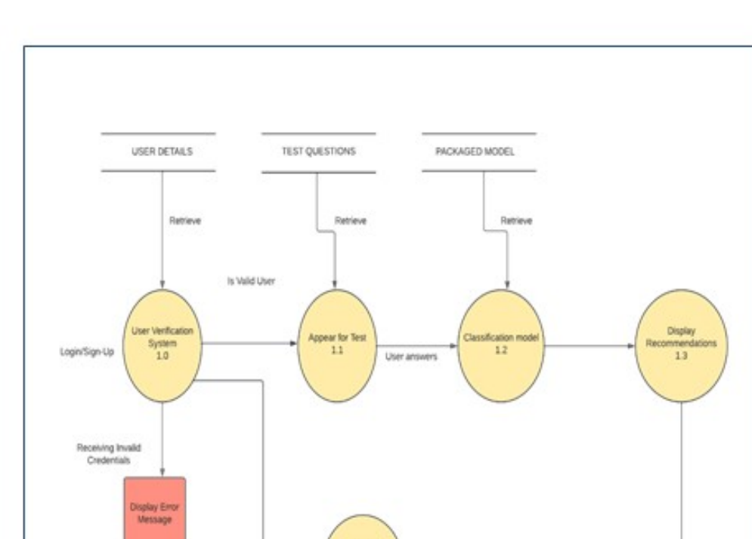
Design Diagrams
Data Flow Diagram (Level 0)
Data Flow Diagram (Level 1)
11

Slide 12
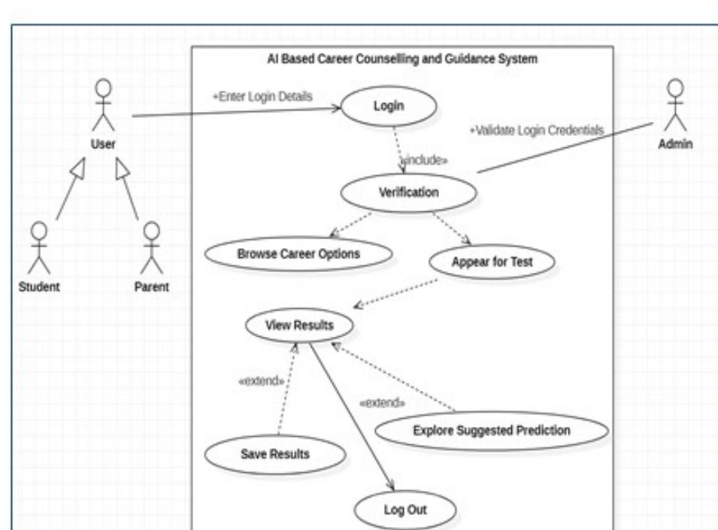
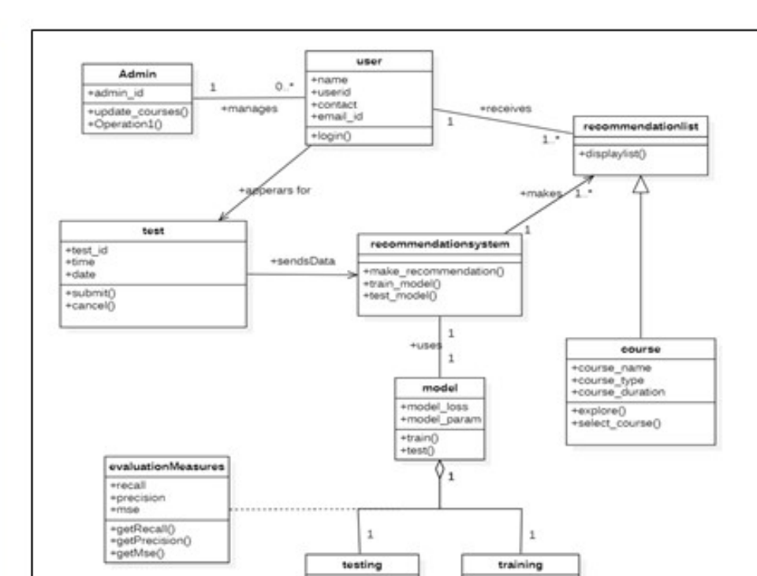
Design Diagrams
Use Case Diagram
Class Diagram
12

Slide 13
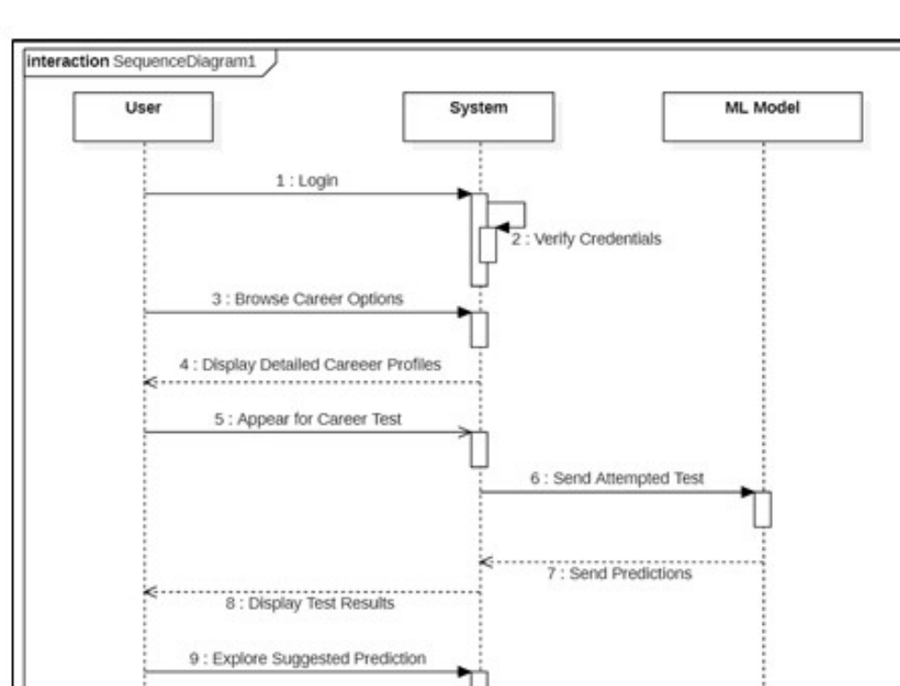
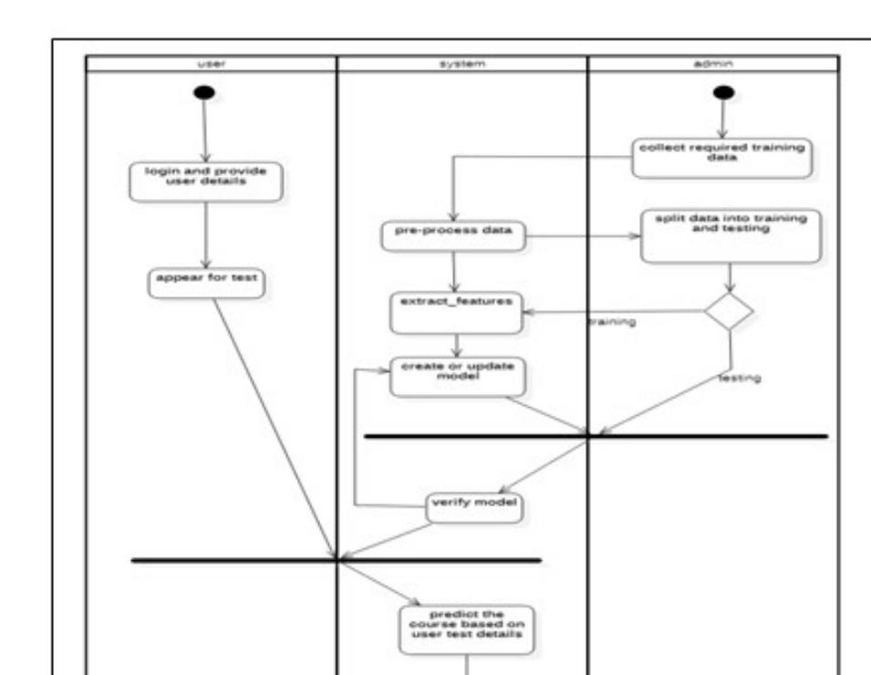
Design Diagrams
Sequence Diagram
Activity Diagram
13

Slide 14
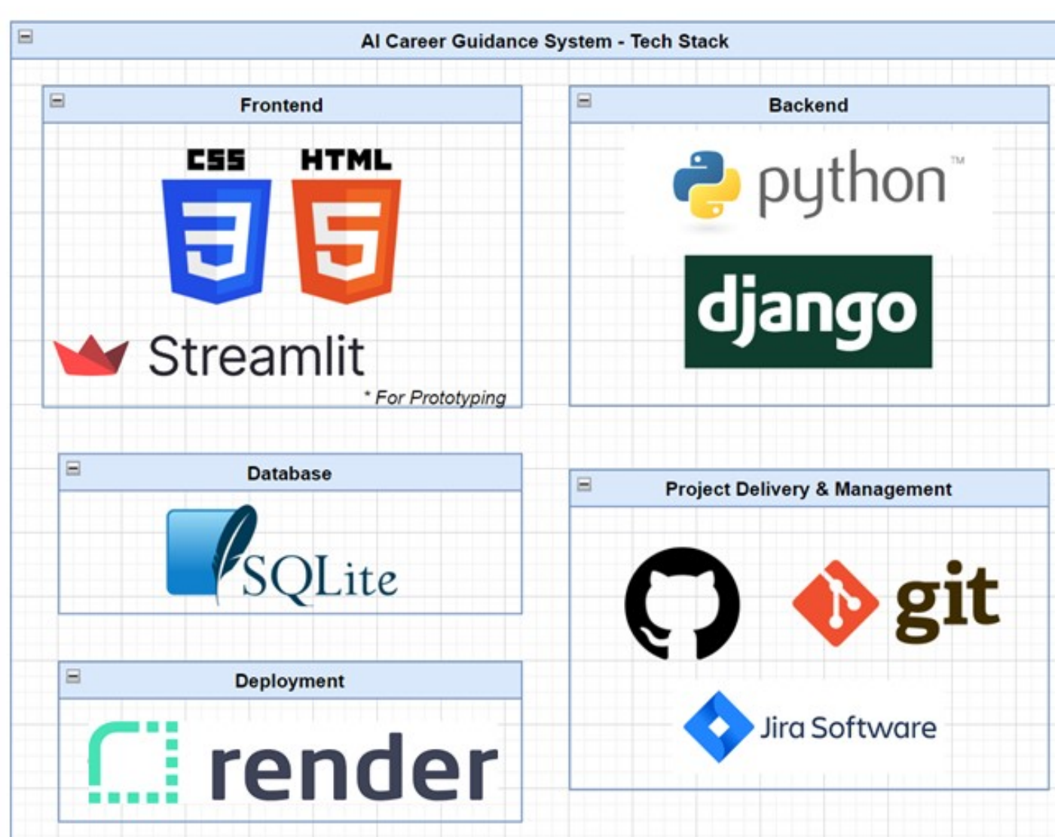
Tech Stack
14

Slide 15
Implementation and Result Discussion
SNo. | Algorithm | Training Accuracy | Testing Accuracy
1. | Decision Tree Classifier | 94.36% | 93.14%
2. | Support Vector Machines | 98.98% | 95.70%
3. | KNN Classifier | 98.52% | 91.78%
4. | Multi Layer Perceptron | 91.04% | 90.14%
5. | Logistic Regression | 99.93% | 99.89%
6. | Gaussian Naive Bayes | 99.96% | 100%
7. | Random Forest Classifier* | 100% | 100%
Note: RFC gives 100% training and testing accuracy, since there is no way of explaining the high accuracy, there is a need to feature engineer the dataset and add weights to existing features for a more robust prediction of the two well performing models.
15

Slide 16
Conclusion and Future Work
After conducting extensive literature review and following a proper project lifecycle, we have achieved the following goals:
▪ Create a model by combining datasets of psychological traits and proficiency in technological skills
▪ Apply Machine Learning models to predict the career of an individual in the field of Computer Science.
▪ Deploy project on web with frontend
We plan to extend the scope of our project to include other factors in choosing careers: financial situation, preferences, social clauses etc.
In the current model, we only cater to roles in the field of computer science, but in future we wish to expand to other fields of study as well.
16

Slide 17

Model Inference Demonstration
Our Deployed Applications
https://ai-career-guidance.onrender.com (Main)
https://pipinstallarya-ai-career-guidance-system-app-streamlit-p-0raw5w.streamlit.app/ (Prototype)
17

Slide 18
References
[1] Tayade, T., Akarte, R., Sorte, G., Tayade, R., Khodke, P. (2021). Data Mining Approach to Job Recommendation Systems. In: Raj, J.S. (eds) International Conference on Mobile Computing and Sustainable Informatics. ICMSI 2020. EAI/Springer Innovations in Communication and Computing. Springer, Cham.
[2] R. Ajoodha, S. Dukhan and A. Jadhav, "Data-Driven Student Support for Academic Success by Developing Student Skill Profiles," 2020 2nd International Multidisciplinary Information Technology and Engineering Conference (IMITEC), 2020, pp. 1-8.
[3] I. Dutta, A. Shah, M. M. Safa and K. Jayavel, "Building a Recommendation System for Career Advice for Students from Professionals," 2022 International Conference on Computer Communication and Informatics (ICCCI), 2022, pp. 1-10.
[4] S. Vignesh, C. Shivani Priyanka, H. Shree Manju and K. Mythili, "An Intelligent Career Guidance System using Machine Learning," 2021 7th International Conference on Advanced Computing and Communication Systems (ICACCS), 2021, pp. 987-990.
[5] J. Britto, S. Prabhu, A. Gawali and Y. Jadhav, "A Machine Learning Based Approach for Recommending Courses at Graduate Level," 2019 International Conference on Smart Systems and Inventive Technology (ICSSIT), 2019, pp. 117-121.
[6] P. D. Schalk, D. P. Wick, P. R. Turner and M. W. Ramsdell, "Predictive assessment of student performance for early strategic guidance," 2011 Frontiers in Education Conference (FIE), 2011, pp. S2H-1-S2H-5.
18

Slide 19
References
[7] R. H. Rangnekar, K. P. Suratwala, S. Krishna and S. Dhage, "Career Prediction Model Using Data Mining and Linear Classification," 2018 Fourth International Conference on Computing Communication Control and Automation (ICCUBEA), 2018, pp. 1-6, doi: 10.1109/ICCUBEA.2018.8697689.
[8] M. Y. Arafath, M. Saifuzzaman, S. Ahmed and S. A. Hossain, "Predicting Career Using Data Mining," 2018 International Conference on Computing, Power and Communication Technologies (GUCON), 2018, pp. 889-894, doi: 10.1109/GUCON.2018.8674995.
[9] B. Harsha, N. Sravanthi, N. Sankeerthana and M. Suneetha, "Career Choice Using Machine Learning Algorithms," 2022 International Conference on Inventive Computation Technologies (ICICT), 2022, pp. 171-176, doi: 10.1109/ICICT54344.2022.9850697.
[10] A. Ghimire, T. Dorsch and J. Edwards, "Introspection with Data: Recommendation of Academic Majors Based on Personality Traits," 2022 Intermountain Engineering, Technology and Computing (IETC), 2022, pp. 1-6, doi: 10.1109/IETC54973.2022.9796766.
[11] C. D. Casuat and E. D. Festijo, "Identifying the Most Predictive Attributes Among Employability Signals of Undergraduate Students," 2020 16th IEEE International Colloquium on Signal Processing & Its Applications (CSPA), 2020, pp. 203-206, doi: 10.1109/CSPA48992.2020.9068681.
19

